Slide 1

CAR RENTAL SYSTEM(RentWheels)
Pagadala Prasad
212222862007

Slide 2


CONTENTS
01 | INTRODUCTION
02 | DESIGN
03 | UML
04 | CLASS & SEQUENCE
05 | MODULES
06 | TESTING
07 | CODE & OUTPUT
08 | INTERFACE
09 | CONCLUSION
10 | FUTURE SCOPE

Slide 3
Abstract
Developed to book a car on rent at the fare charges.
Automates car rental management system.
Provides a complete solution for car booking needs.
Responsive web interface for customers and admin.
Allows customers to view models, descriptions, and prices.

Slide 4
Introduction
1.Car rental agencies provide short term vehicle leasing.
2.Increasing preference among students and others.
3.Importance of web-based systems for convenience.
4.Issues with public transportation and taxi fares.
5.Benefits of the Car Rental System for effective transport utilization.

Slide 5
Existing System
1.Direct interaction with car owner.
2.Time-consuming manual process.
3.Limited accessibility and choices.
4.Inaccurate and time-consuming booking process.
5.Limited to local customers.

Slide 6
Proposed System
Online booking for car rentals.
Simplifies vehicle and staff management.
User-friendly and budget-friendly system.
Accessible from anywhere.
Easy booking cancellation and more car choices.

Slide 7
Proposed System - Advantages
Online accessibility from anywhere.
Easy booking cancellation.
More car choices.
Increased customer retention.
Simplifies management processes.

Slide 8
Hardware Configuration
Processor: Intel I3 Processor.
RAM: 4 GB.
Monitor: 15 inch color monitor or LED.
Hard disk: 160 GB.
Standard keyboard and optical mouse.

Slide 9
Software Configuration
Operating system: Windows.
IDE: Eclipse.
Language: Java.
Framework: JSP and JDBC.
Back End: MySQL, Front End: HTML, CSS, JS, Bootstrap, Server: Apache Tomcat.

Slide 10
System Design
High-level design diagram.
Database design.
User interface mockups.
Data flow diagrams.
System architecture.

Slide 11
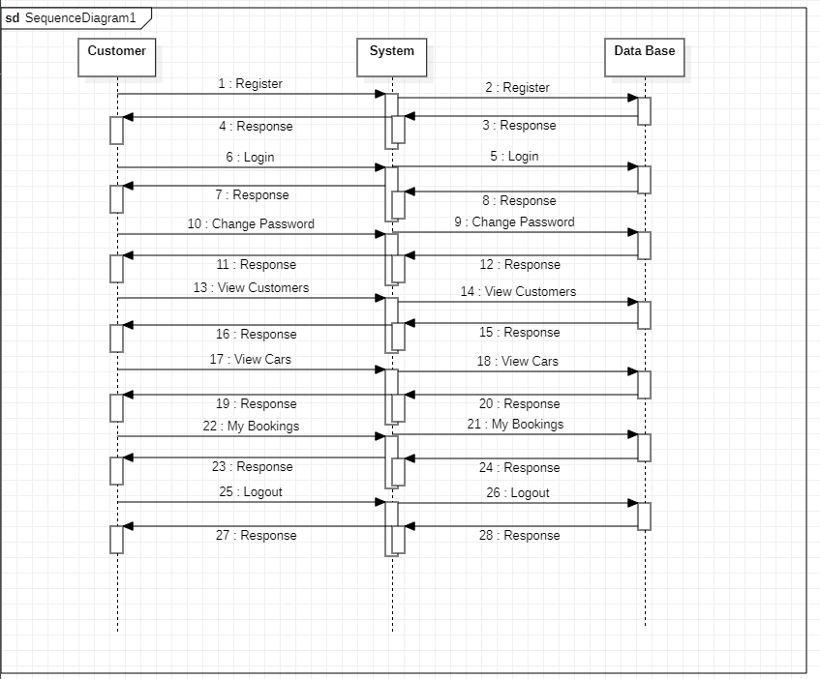
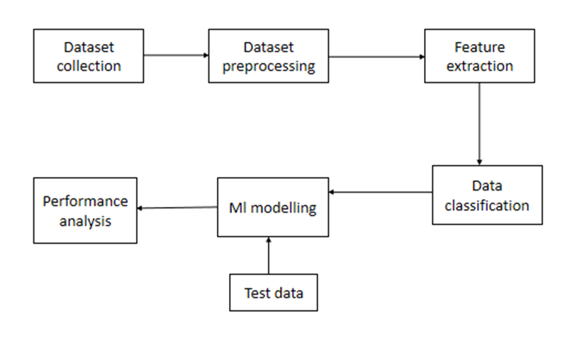
SYSTEM DESIGN

Slide 12
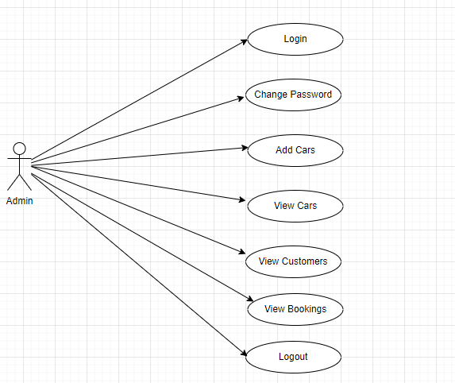
Admin-Use Case Diagram:

Slide 13
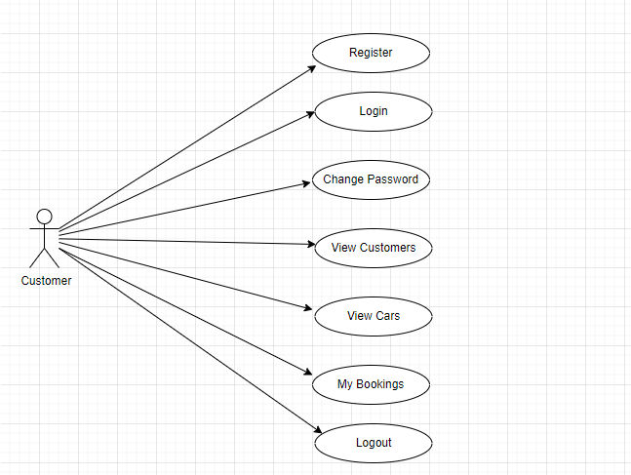
Customer-Use Case Diagram:

Slide 14
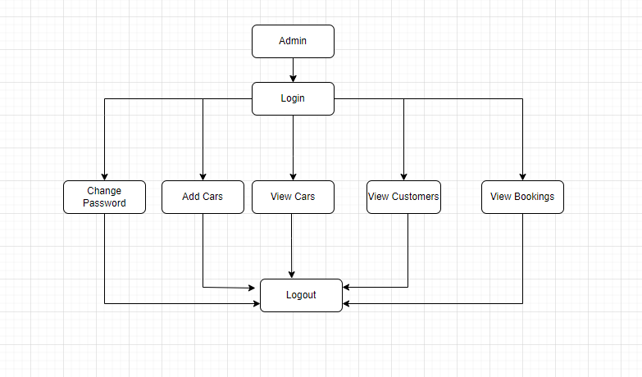
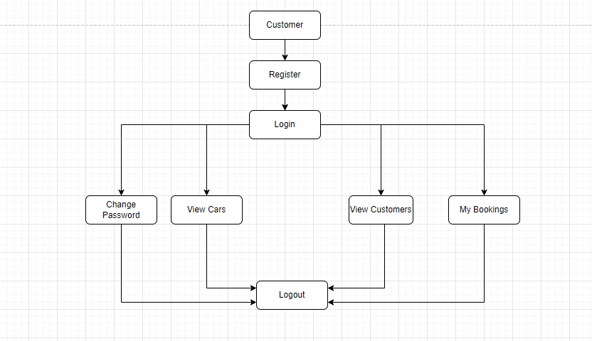
Admin & Customer Activity Diagram:

Slide 15
Modules
Administrator
Vendors
Customers
User registration and login
Booking management

Slide 16

OUTPUT

Slide 17
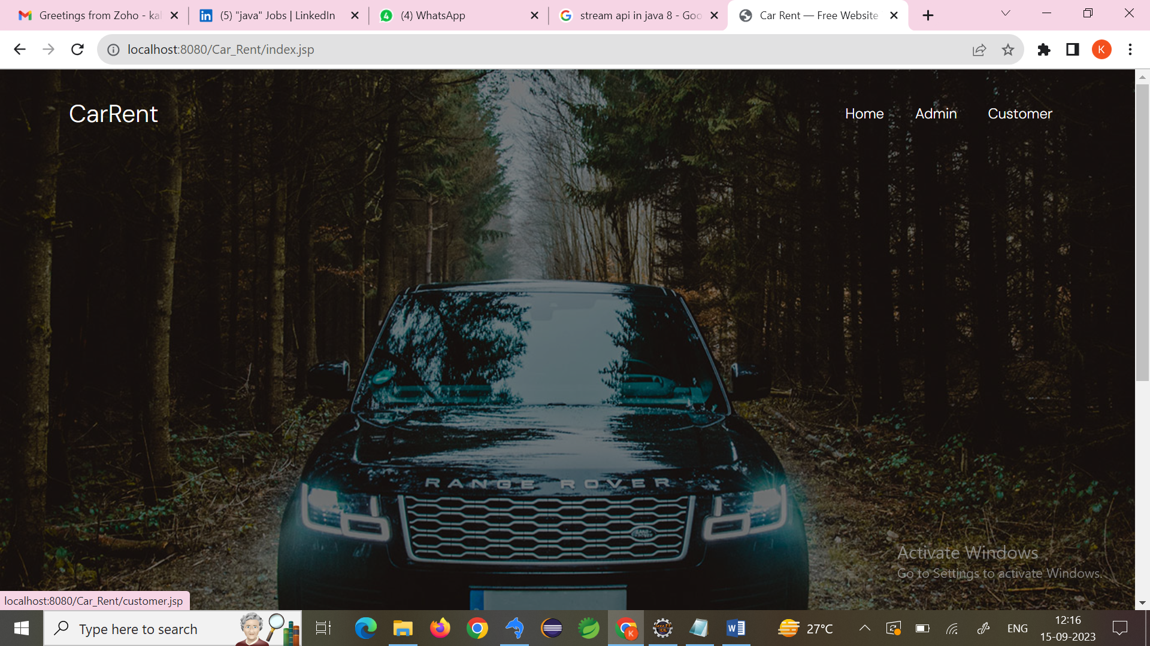
APPLICATION INTERFACE :-

Slide 18
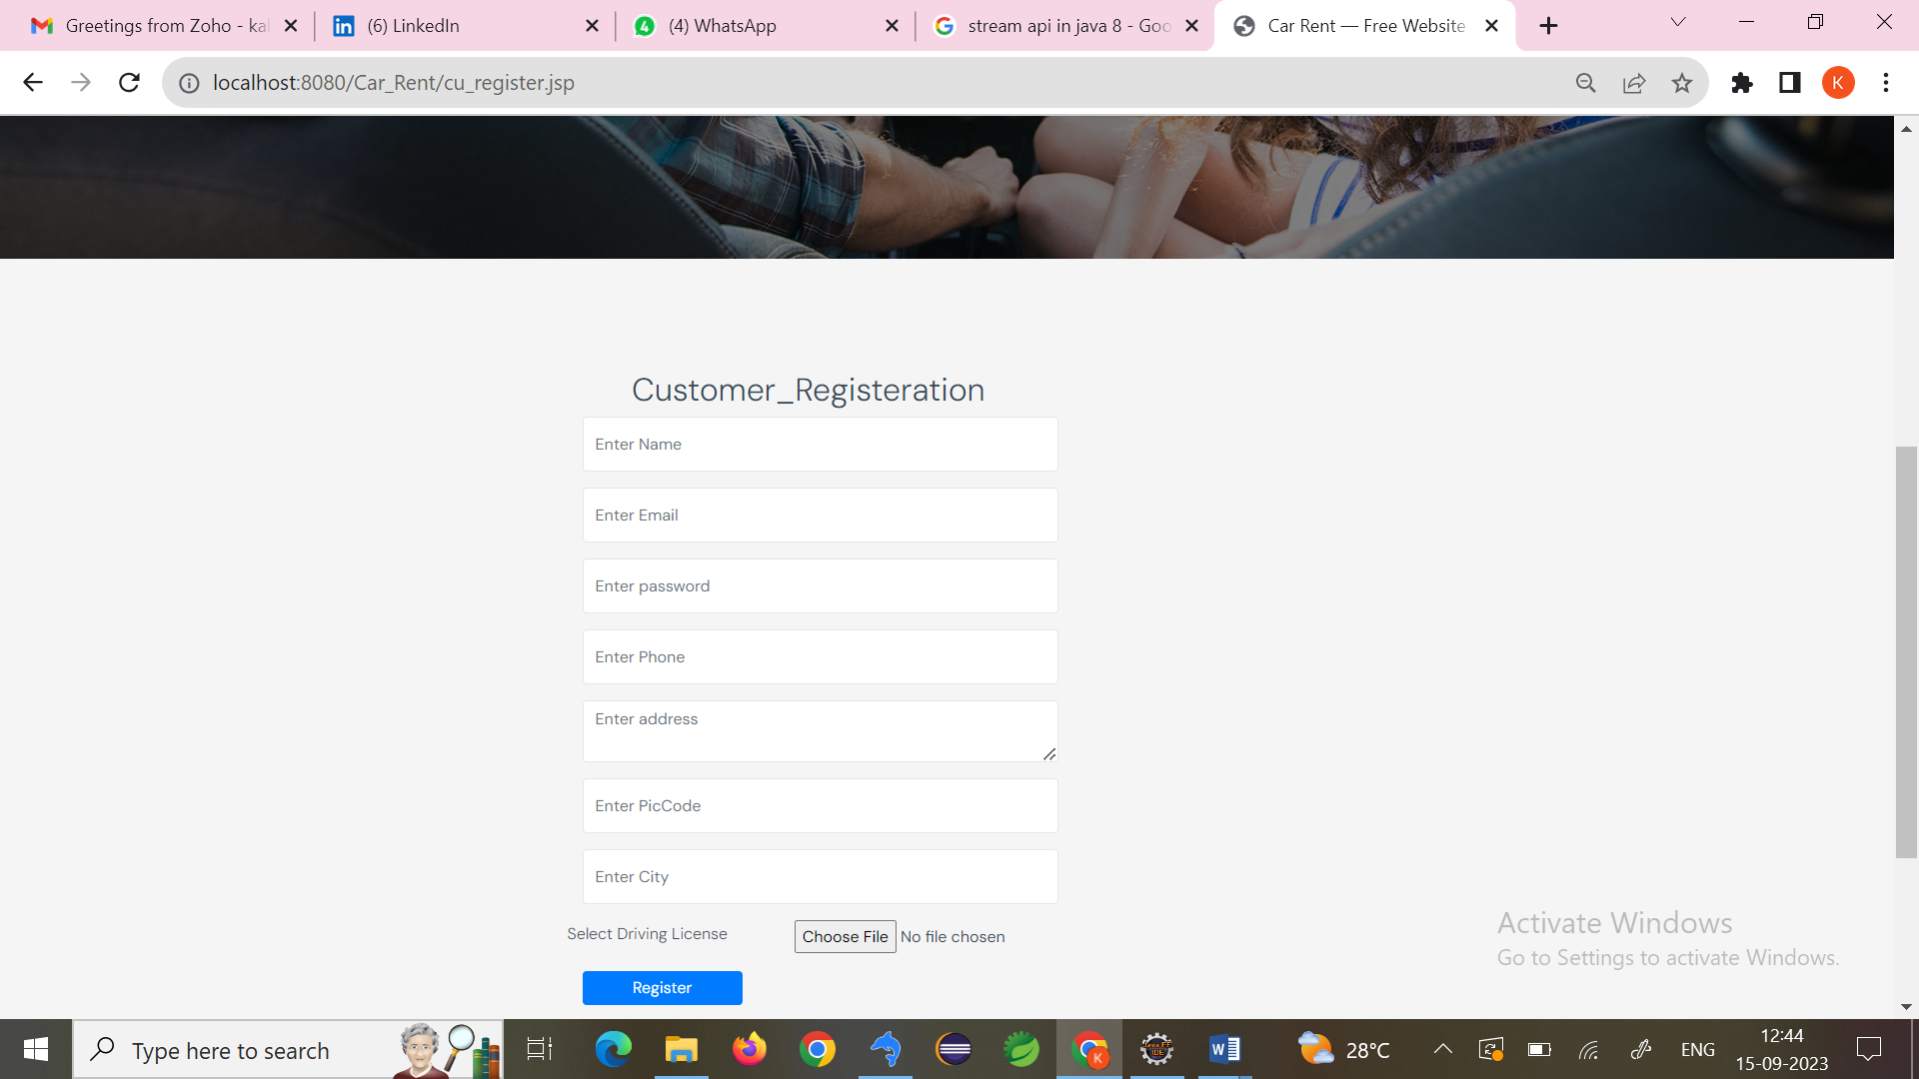
SIGN UP PAGE :-

Slide 19
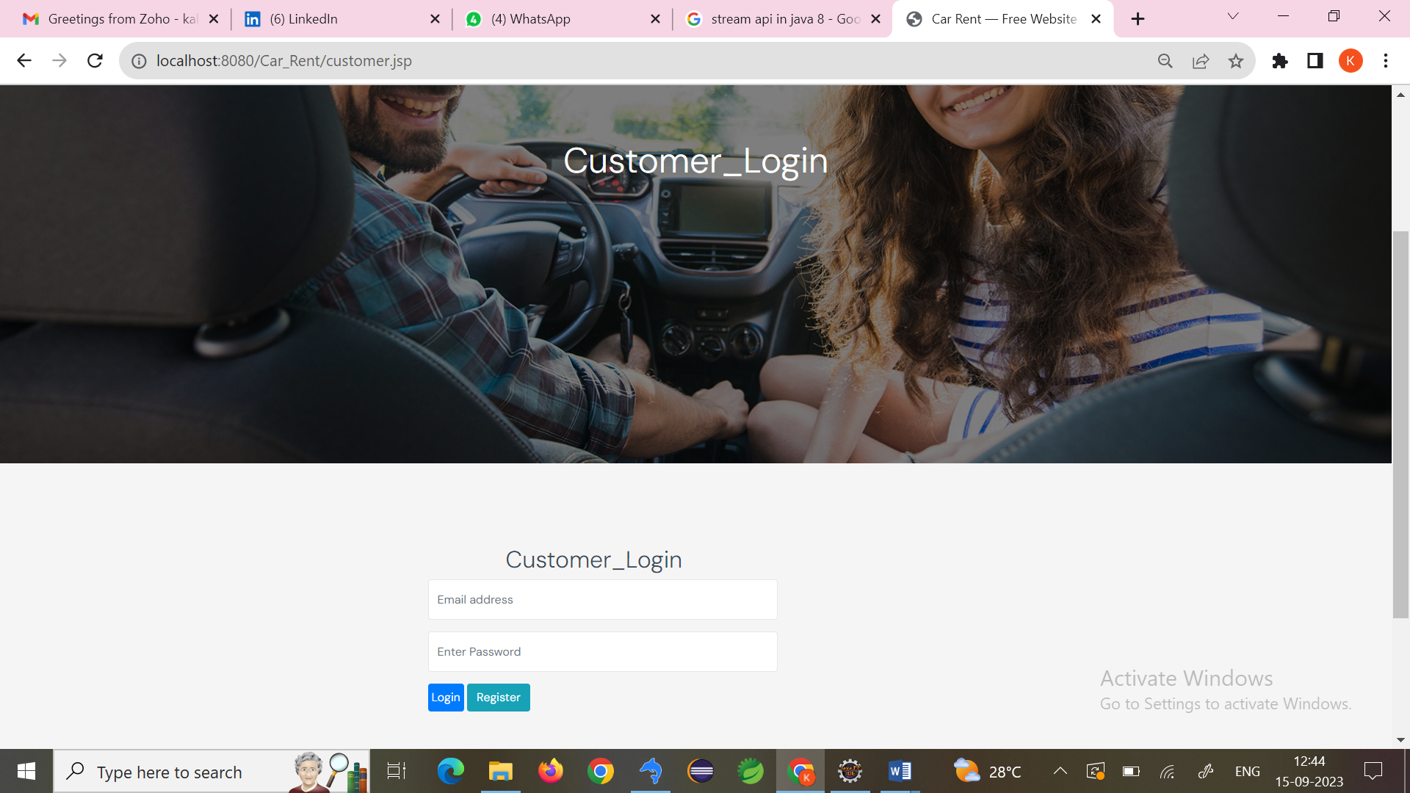
LOGIN PAGE :-

Slide 20
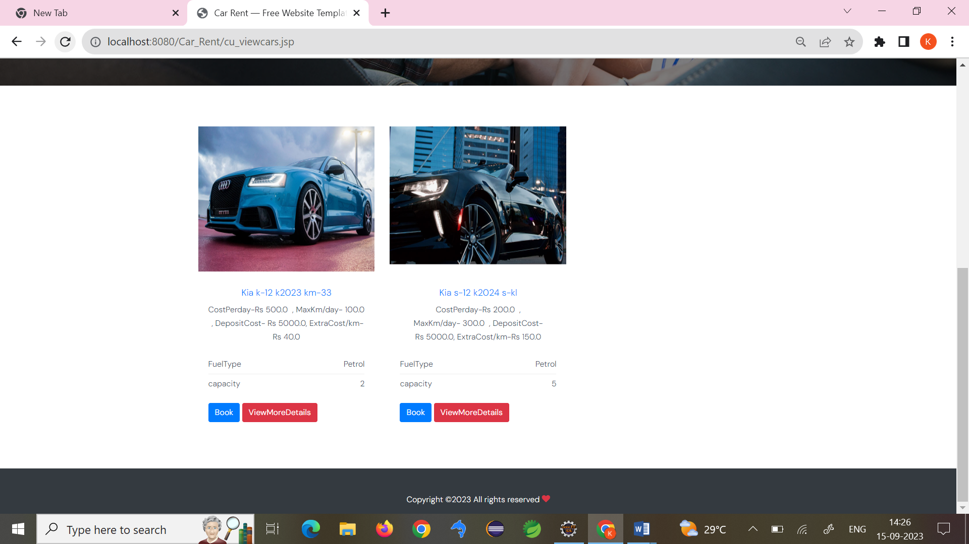
VIEW CAR

Slide 21
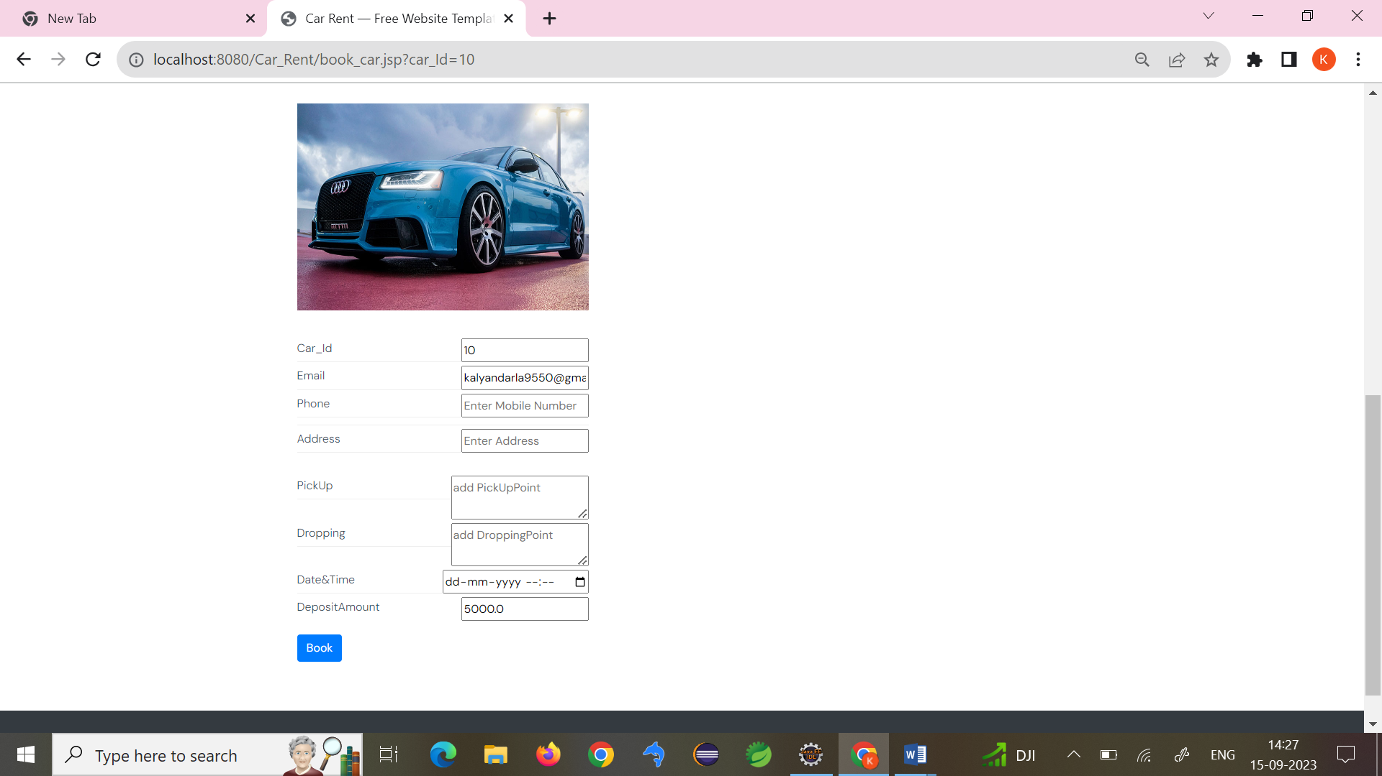
BOOK CAR:-

Slide 22
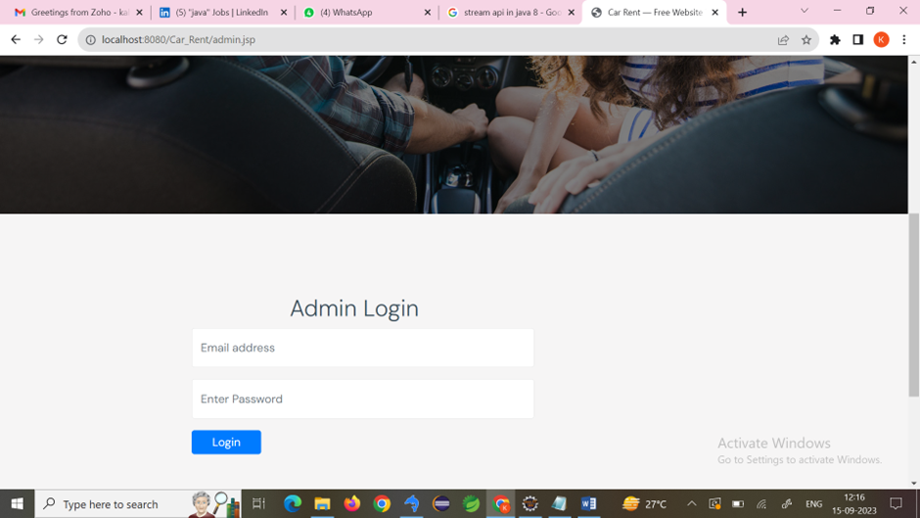
ADMIN LOGIN:-

Slide 23
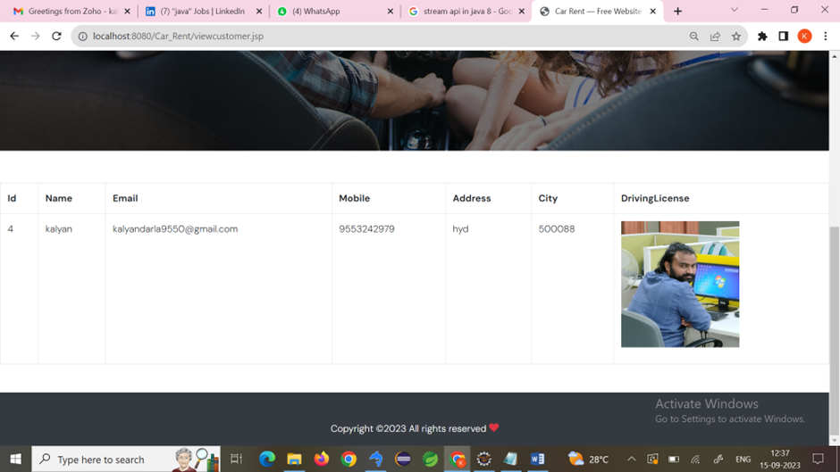
VIEW CUSTOMER:-

Slide 24
Implementation Highlights
Key development milestones.
Challenges overcome.
Successful deployment of the system.
Testing and quality assurance.
User training and support.

Slide 25
Future Scope
Potential enhancements.
Scalability options.
Integration with other services.
Continuous improvement.
Expanding to new markets.

Slide 26
Conclusion
Benefits of web-based rental management.
Efficient data storage and cost control.
Promotes renting over buying for environmental benefits.
User-friendly and accessible.
Provides a competitive edge.

Slide 27
THANK YOU

